Slide 1

G2M Case Study
Virtual Internship
08-Jun-2022

Slide 2
Background –G2M(cab industry) case study
XYZ is a private equity firm in US. Due to remarkable growth in the Cab Industry in last few years and multiple key players in the market, it is planning for an investment in Cab industry.
Objective : Provide actionable insights to help XYZ firm in identifying the right company for making investment.
The analysis has been divided into three parts:
Data Understanding
Investigate 5 hypothesis
Recommendations for investment

Slide 3
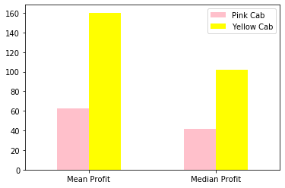
Profit Analysis
Which cab company, has the biggest profit ?
The bar plot denotes the mean profit and the median profit for each company. It is clear, that Yellow company is more profitable.

Slide 4
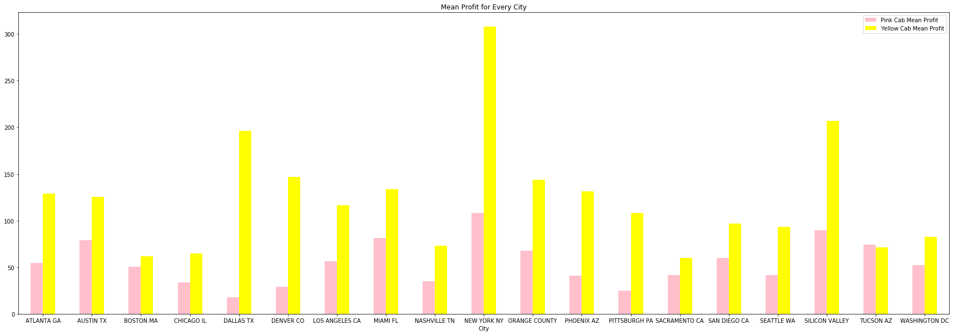
In which city, every cab company has bigger profit ?
Except TUCSON AZ city, in every other city, yellow cab company has bigger profits than pink cab company
So, most people prefer yellow cab rather than pink cab in almost every city, except TUCSON AZ
The city with the bigger profit is New York City, for both companies

Slide 5
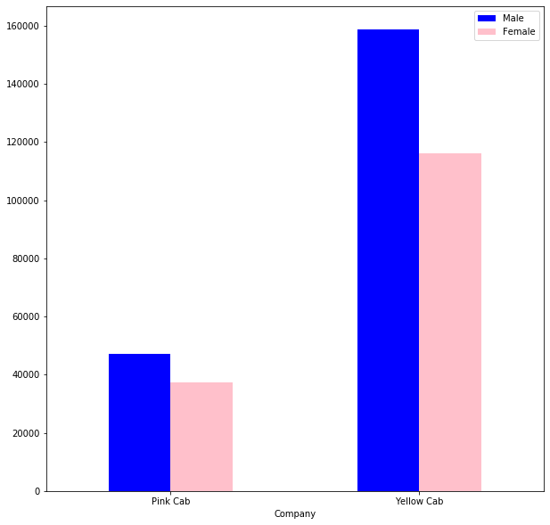
For every cab company, male or female people, use a cab more often ?
Men tend to use more often a cab than women.

Slide 6
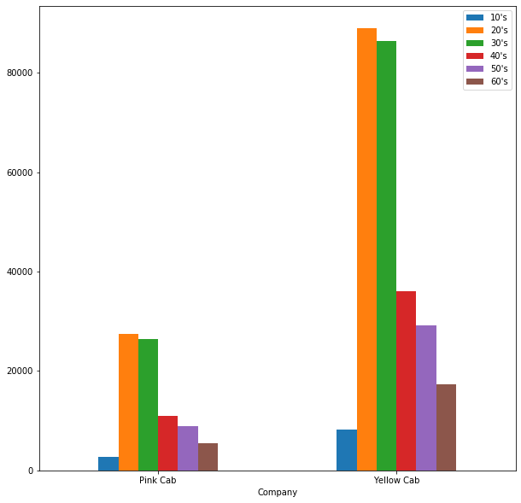
For every company, which ages use a cab more often ?
It is obvious that people between 20 and 29 use cab more often than the other ages in both cab companies.

Slide 7
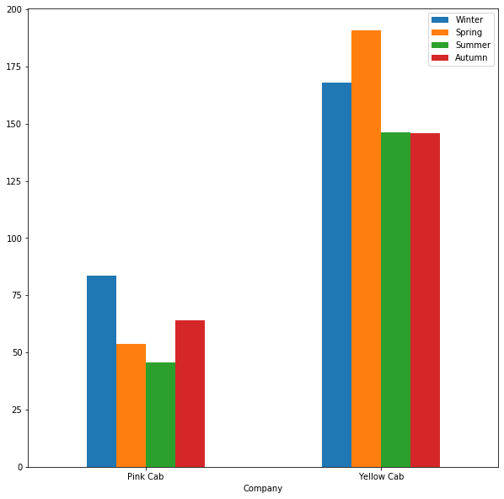
For every company, which season is considered more profitable?
We can point out that for the Pink company, winter is more profitable and for the Yellow company Spring is more profitable.

Slide 8
Recommendations
We have evaluated both the cab companies on following points and found Yellow cab better than Pink cab:
Generally, Yellow company is more profitable from Pink Company
For both companies, New York City is more profitable, but again the profits of Yellow company are much bigger. In every city except TUCSON AZ, Yellow company is more profitable
For both companies, men use more often a cab
People aged 20 to 29, tend to use a cab more often for both companies. For Yellow company the profits from older people are also very high, so yellow company has customers from all ages
For Yellow company, spring is considered the most profitable season, while for Pink company winter. Again the profits of the Yellow company are way bigger than the profits of Pink company, in all seasons
On the basis of above point , we will recommend Yellow cab for investment.

Slide 9
Thank You

